Slide 1
Credit Risk Assessment
using Machine Learning
Digital Practice
Prolifics
Client Confidential | Copyright © 2017 Prolifics
Notes:
What do we want the title for the deck to be?

Slide 2
Agenda
What is Credit Risk?
Key Terminologies
Scenario Based Explanation
Demo
Data Overview
Model Overview
Model Execution
Model Enhancements
Predictive Modelling Roadmap
QnA

Slide 3
Credit Risk Management
Loan
Lender
Credit Risk
Borrower
Interest+ Principal
Credit Lifecycle
Manage
Customer Lifecycle
Assess
Dimensions
Evaluate
Credit Risk
Measure
Expected Loss
Credit Risk Management
February 24, 2020
Confidential | Copyright © 2017 Prolifics

Slide 4






Need for Modelling
Valuable Customer
Finding Defaulters
Finding Interest Rate
Boomerang Customers
Exempted Customers
Adequate Locking Amount
Acceptable Risk

Slide 5
Key Derivatives
Likelihood that a borrower will not be able to make repayments
Share of an asset that is lost when borrower defaults
Maximum amount that a bank may lose
Amount a bank expects to lose when extending credits to customers
Amount held by bank to absorb the loss
PD
LGD
EAD
EL
CA
EL= PD*LGD*EAD
February 24, 2020
Confidential | Copyright © 2017 Prolifics

Slide 6
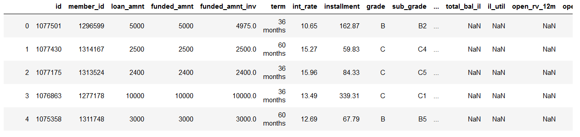
Data Overview
Data Source: Loan repayment data of an Indian Bank from 2007-14
Total records: 47000
Dimensions: 74
Dimension Details: Financial Details, Personal Details, Employment details, Repayment history etc.

Slide 7
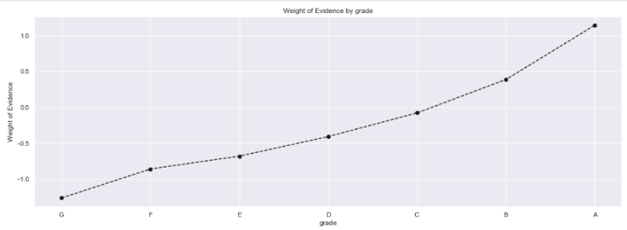
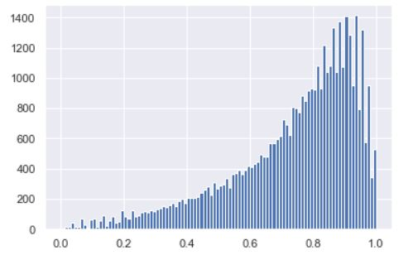
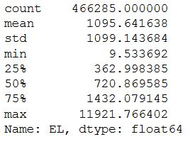
Model Analysis
Data Pattern
Fairly High Dimension
Linear Separable
Interpretability Requirement
No Latency Constraint
Algorithm Used
Logistic regression
Beta Regression
Feature Engineering
P-value selection method
Split Ratio
80:20 Train Test Split
Calculated output
Probability of Default(PD)
Expected Loss(EL)
Weight of Grade on Model
Loan Default v/s Exposed factor
5 Point Summary

Slide 8





Business Benefits
High Satisfaction Index
Virtual
Workforce
In-House
Assessment
Monetary Benefits
Surplus
Adequate Amount
High Risk
Capital Adequacy Amount

Slide 9











Model Overview
Data
Build
Score
Deploy
Deployment

Slide 10

Predictive Modelling Roadmap
Modelling Objective
Gain Processing Efficiency
Smarter Workforce Utilization
Reduce risk
Reduce Operational Cost
Meet consumer expectations
Better marketing campaigns
Phase 1
Phase 2
Phase 3
Scope
Scope
Scope
Create a basic predictive model for the use case (Happy Path)
Create the required model
Feature Enhancement
Model Deployment
BI Integration
Enhance the scope of the model
Tasks
Tasks
Tasks
Domain Understanding
Data Understanding
Modelling
Feature Engineering
Performance Evaluation
Use advance modelling techniques
Evaluate multiple platforms
Advance Feature Engineering Techniques
Custom reports and Dashboards
Enhanced exception handling
Customized security configurations
MLOPS
February 24, 2020
Confidential | Copyright © 2017 Prolifics

